Slide 1
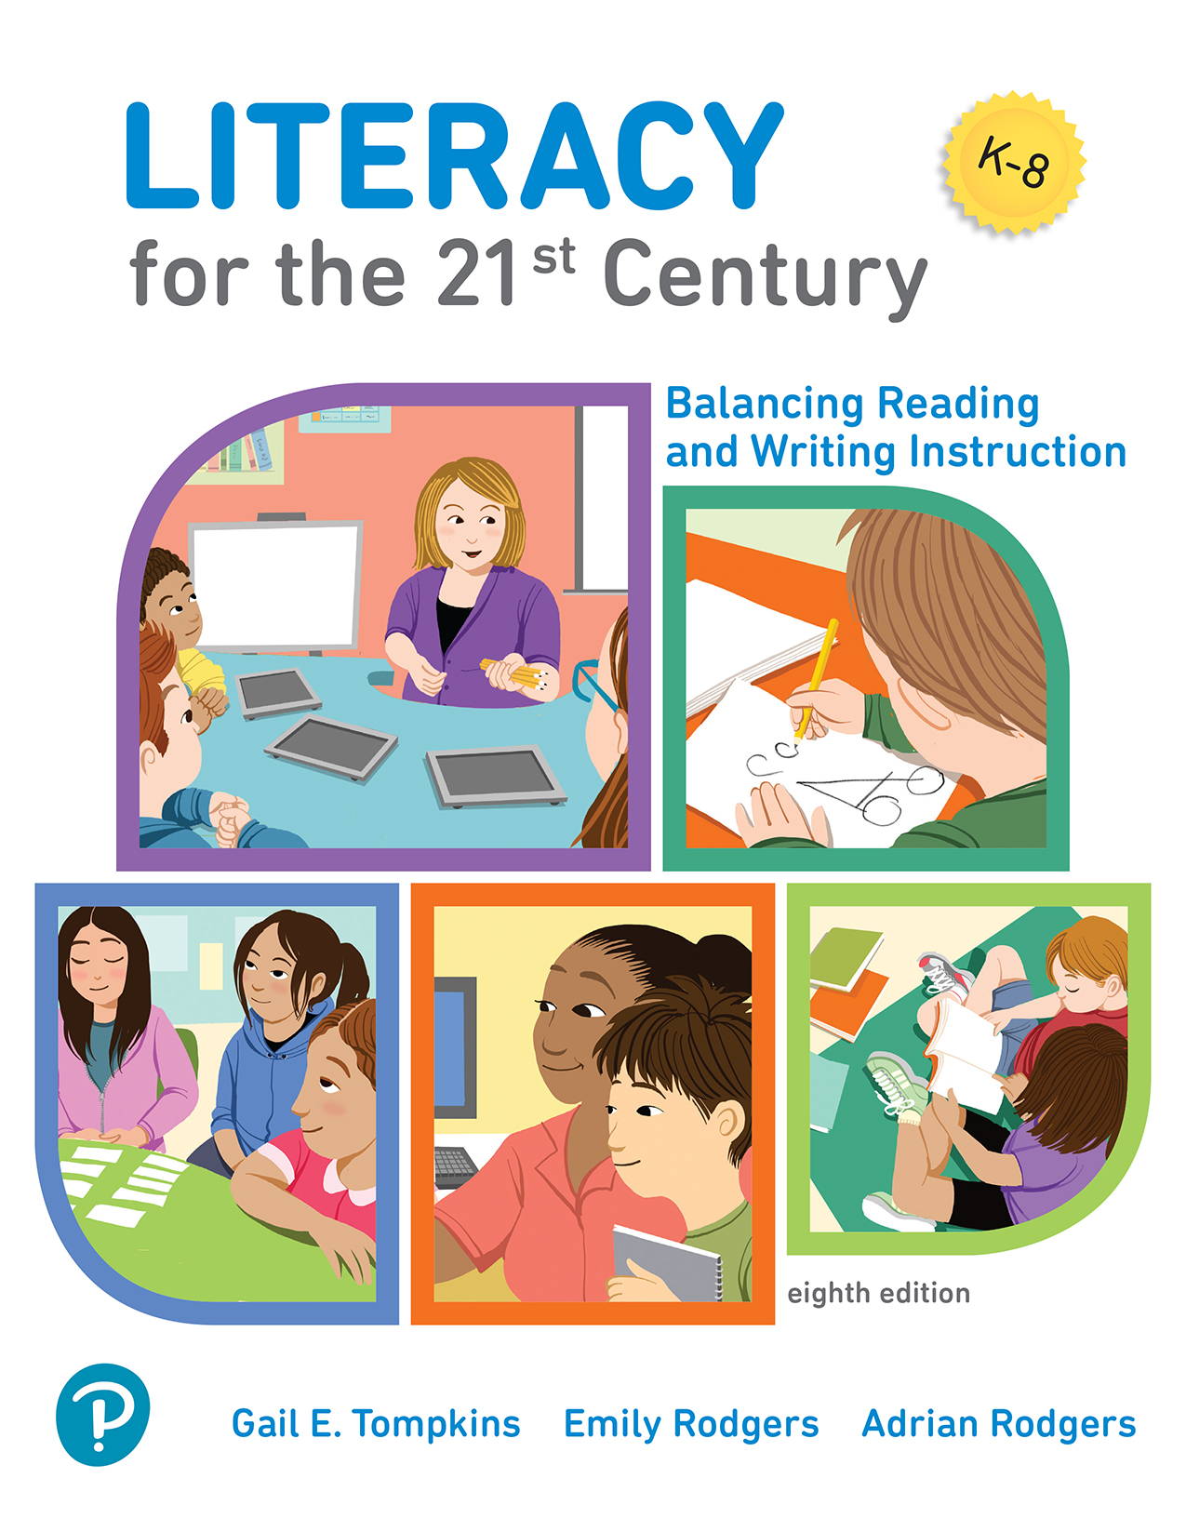
Literacy for the 21st Century: Balancing Reading and Writing Instruction
Eighth Edition
Chapter 2
Examining Students’ Literacy Development
Copyright © 2022, 2017, 2014 Pearson Education, Inc. All Rights Reserved
Notes:
If this PowerPoint presentation contains mathematical equations, you may need to check that your computer has the following installed:
1) MathType Plugin
2) Math Player (free versions available)
3) NVDA Reader (free versions available)

Slide 2
Learning Outcomes
2.1 Explain how teachers promote young students’ oral language development.
2.2 Describe the three stages that students move through as they develop as readers and writers.
2.3 Identify instructional methods that promote early literacy development in reading and writing.

Slide 3
Promoting Students’ Oral Language Development
Students develop expertise in all four language modes:
Phonology
  Children manipulate language.
Syntax
  Children combine words into sentences.
Semantics
  Children learn the meanings of words.
Pragmatics
  Children use language socially.

Slide 4
Oral Language Activities at School
Children develop oral language competence as they participate in literacy activities including:
Grand Conversations
Book talks
Interactive Read-Alouds
Interactive Writing
Shared Reading
Story Retellings
Story Boards

Slide 5
Assessing Students’ Oral Language
Teachers use observations during conversations, anecdotal notes, checklists, and video clips to monitor whether children:
Listen during conversations about books
Play with words
Connect new words to technical concepts they’re learning
Use new vocabulary words appropriately as they talk and write

Slide 6
How Students Develop as Readers and Writers
Young students move through 3 stages as they learn to read and write:
Emergent
Beginning
Fluent

Slide 7
Emergent Reading & Writing
During the emergent stage, students:
Develop an interest in reading & writing
Acquire concepts about print
Develop book-handling skills
Identify the letters of the alphabet
Read & write some high-frequency words

Slide 8
Beginning Reading & Writing
During the beginning stage, students:
Learn phonics skills
Recognize 100 high-frequency words
Apply early reading strategies
Write five or more sentences
Spell phonetically
Spell 50 high-frequency words
Capitalize letters at the beginnings of sentences
Use punctuation marks to indicate the ends of sentences
Reread their writing

Slide 9
Fluent Reading & Writing
During the fluent stage, students:
Read fluently and with expression
Recognize most one-syllable words automatically and decode other words efficiently
Use decoding and comprehension strategies effectively
Write well-developed, multi-paragraph compositions
Use the writing process to draft and refine their writing
Write stories, reports, letters, and other genres
Spell most high-frequency and other one-syllable words correctly
Use capital letters and punctuation marks correctly most of the time

Slide 10
Teaching to Promote Early Literacy Development (1 of 9)
Teaching Concepts about Print: What Students Learn
Young children learn that:
print carries meaning
letters and words represent spoken language
reading and writing are used for a variety of purposes

Slide 11
Teaching to Promote Early Literacy Development (2 of 9)
Teaching Concepts about Print: What Teachers Do
Kindergarten teachers:
demonstrate the purposes of written language
provide opportunities for students to experiment with reading and writing

Slide 12
Teaching to Promote Early Literacy Development (3 of 9)
Teaching Concepts about Print: What Teachers Do
Post signs in the classroom
Integrate reading and writing materials into literacy play centers
Have students exchange messages with classmates
Read and write stories
Label classroom items
Have students draw and write in journals
Have students write notes to their parents

Slide 13
Teaching to Promote Early Literacy Development (4 of 9)
Teaching Concepts about Print: What Teachers Do
Kindergarten teachers
Use shared reading to read aloud books that are appropriate for students’ interests, but too difficult to read by themselves.
Use predictable books for shared reading (books that have repeated sentences, rhymes, or other patterns).

Slide 14
Teaching to Promote Early Literacy Development (5 of 9)
Teaching Concepts about Print: What Teachers Do
Steps in Shared Reading
Prereading
Reading
Responding
Exploring
Applying

Slide 15
Teaching to Promote Early Literacy Development (6 of 9)
Teaching Concepts about Print: What Teachers Do
Predictable Books Contain:
Repetition
Cumulative Sequence
Rhyme and Rhythm
Sequential Patterns

Slide 16
Teaching to Promote Early Literacy Development (7 of 9)
Teaching Concepts About Words: What Children Learn
print carries meaning
letters and words represent spoken language
reading and writing are used for a variety of purposes

Slide 17
Environmental Print
Young children begin reading by recognizing logos on fast-food restaurants, department stores, and grocery stores.
At first, young children depend on context to read familiar words and memorized texts.

Slide 18
Literacy Play Centers
Young students learn about the purposes of reading and writing as they use written language in their play.
Kindergarten teachers add literacy materials to play centers to enhance their value for literacy learning
Some examples of Literacy Play Centers
Bank
Grocery store
Medical
Restaurant

Slide 19
Teaching to Promote Early Literacy Development (8 of 9)
Teaching Concepts About the Alphabet: What Teachers Do
Capitalize on students’ interests
Talk about the role of letters in reading and writing
Provide a variety of opportunities for alphabet learning including:
  using students’ names and environmental print in literacy activities
  using interactive writing
  allowing students to use invented spelling in their own writing
  sharing alphabet books
  playing letter games

Slide 20
Teaching to Promote Early Literacy Development (9 of 9)
Teaching Concepts of Writing: What Teachers Do
Morning Message
Language Experience Approach
Interactive Writing
Writing Centers

Slide 21
Assessing Students’ Knowledge About Print
Teachers use Marie Clay’s Concepts About Print (C A P) Test to assess understanding of written language concepts.
Teachers observe children as they:
Look at books and reread familiar ones
Do pretend writing
Write their names and other familiar words

Slide 22
Chapter 2 Examining Students’ Literacy Development Review
Teachers promote students’ language development and build their vocabulary.
Teachers understand that students progress through the emergent, beginning, and fluent stages of literacy development as they become proficient readers and writers.
Teachers promote early literacy development by teaching concepts about print in reading and writing.

