Slide 1
Creating Inclusive Classrooms: Effective and Reflective Practices
Topic: Chapter 1: Understanding Inclusion Day 2, cont.
Copyright © 2016, 2011, 2008 Pearson Education, Inc. All Rights Reserved
Notes:
If this PowerPoint presentation contains mathematical equations, you may need to check that your computer has the following installed:
1) Math Type Plugin
2) Math Player (free versions available)
3) NVDA Reader (free versions available)

Slide 2
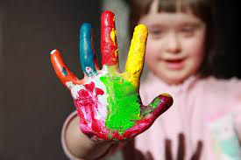
Welcome Back!
In this presentation, I will discuss:
What is a Specific Learning Disability?
Special Education
Continuum of Educational Placements
Benefits of Early Intervention & Placements

Slide 3
According to IDEA, SLD is “a disorder in one or more of the basic psychological processes involved in understanding or in using language, spoken or written, which disorder may manifest itself in the imperfect ability to listen, think, speak, read, write, spell, or do mathematical calculations. Such term includes such conditions as perceptual disabilities, brain injury, minimal brain dysfunction, dyslexia, and developmental aphasia. Such term does not include a learning problem that is primarily the result of visual, hearing, or motor disabilities, of mental retardation*, of emotional disturbance, or of environmental, cultural, or economic disadvantage.”

Slide 4

Special Education Teacher shares more information about Common Learning Disabilities: https://youtu.be/UAF706IeV8Q

Slide 5
“Learning disabilities are not a prescription for failure. With the right kinds of instruction, guidance and support, there are no limits to what individuals with LD can achieve.” Sheldon H. Horowitz, Ed.D., Director of LD Resources National Center for Learning Disabilities

Slide 6
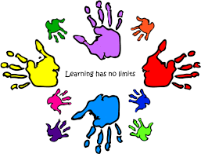
Special Education

Slide 7
Special Education:
What is Special Education? https://youtu.be/9DktV772njY

Slide 8
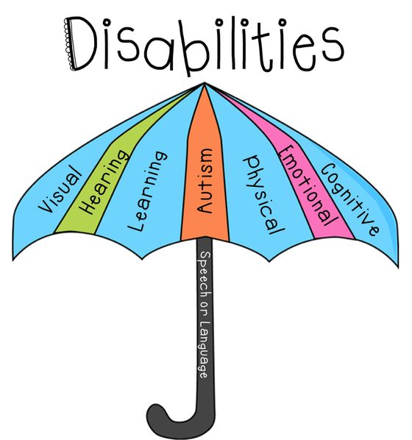
Special Education:

Slide 9
Special Education:
Disability Categories:
Autism Spectrum Disorders
Deafness & Hearing impairments
Deaf-Blindness
Intellectual Disorders
Multiple Disorders
Orthopedic Impairment
Other health impairment
Specific learning disability
Speech/language impairment
Blindness & visual impairment
Developmental delays

Slide 10

What is Special Education?
Special education is an approach to teaching children with disabilities that takes into account the barriers those children have to learning in a more typical way.
Special education can include changes to:
the way material is taught
used in the classroom
lessons are specialized
& other supports that target a disabled child’s unique way of learning & unique needs.

Slide 11
Who Should Get Special Education?
Who Should Get Special Education? To know if a child should get special education, answer these three questions:
1) Does the child have a disability?
2) Does the child’s disability get in the way of successful learning?
3) Does the child need some kind of special education, different from what is offered to the other children, in order to make good progress?

Slide 12
Who Should Get Special Education?
If the answer is YES to all three questions, then the child should get special education.

Slide 13
Where is Special Education Provided?
Special education can be provided in lots of different environments.
Most of the time, it is provided in the child’s assigned public school in a regular classroom.
For some children, it’s too hard to learn in a regular classroom, even if the child gets lots of support there.
For those children, special education can be provided in separate classrooms or even, on a very few occasions, in separate schools.

Slide 14
What are the Steps for Getting Special Education?
Referral – A teacher or parent notices that a child is struggling in school and may benefit from special education. That person writes a brief letter to the principal to ask that the child be evaluated for special education. This written request is called a “referral.” Only parents or school staff can make an official referral.

Slide 15
What are the Steps for Getting Special Education?
Evaluation – A child is tested, or evaluated, to identify her strengths, weaknesses, and needs.
Eligibility decision – After the testing, a group, including the parent, uses the evaluation and other information to determine if a child is eligible for special education.
Development of special education program – An individualized education program (known as an IEP) is developed by a team to set goals

Slide 16
What are the Steps for Getting Special Education?
Delivery of special education services – The child receives special education and related services as described on her IEP
Annual review – Once a year, the child’s IEP team reviews and updates the special education program. This continues until the child is found to no longer need special education, or until the child graduates from high school. Additional meetings between annual reviews can be scheduled to make necessary interim changes to the child’s IEP.

Slide 17
What are the Steps for Getting Special Education?
Reevaluation – At least every three years, each eligible child is reevaluated. Reevaluation has two purposes. First, it helps the IEP team determine if a child still qualifies for special education. Second, if the child still qualifies, it helps the IEP team with planning for future educational needs.

Slide 18
Referral Process
Special education services are available for children over the age of three through age 21 who have an Individualized Education Program (IEP). The Individuals with Disabilities Education Improvement Act (IDEA) provides the legal grounds for children with disabilities to receive a free appropriate public education (FAPE) in the least restrictive environment (LRE). These services are administerred by the school district where the child lives.
Referral Process: https://youtu.be/TBdrK4kKWsg
Special Education Resources Explained: Special Education - disAbility Law Center of Virginia (dlcv.org)

Slide 19
Special Education:
Involves delivering & monitoring a specially designed and coordinated set of comprehensive, evidence-based & universally designed instructional and assessment practices through:
Individualized assessment
Specialized instruction
Intensive instruction
Goal-directed instruction
Evidence-based instruction
Collaborative partnerships
Student performance evaluations

Slide 20
Continuum of Educational Placements:
A student is placed in the least restrictive learning environment based on his or her strengths and challenges
A student moves to a less restrictive environment as quickly as possible and moves to a more restrictive one only when necessary.
.
See Figure 1.2 for a range of most to least restrictive educational placements for students (next slide):

Slide 21
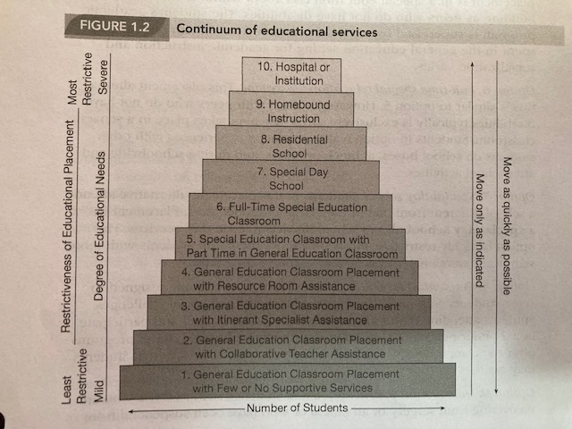

Slide 22
Continuum of Educational Placements (1 of 2)
Option 1: classroom placement with few or no supportive services.
Option 2: classroom placement with collaborative teacher assistance.
Option 3: classroom placement with itinerant specialist assistance
Option 4: classroom placement with resource room assistance.
Option 5: classroom placement with part time in the general education classroom
Option 6: Full-time special education classroom

Slide 23
Continuum of Educational Placements (2 of 2)
Districts must consider:
Anticipated outcomes of gen ed compared to benefits of special ed classrooms
Impact on classmates without disabilities
Option 7: Special day school
Option 8: Residential school
Option 9: Homebound instruction
Option 10: Hospital or institution

Slide 24
Factors Contributing to Inclusion
What factors contributed to the movement to educate learners in inclusive classroom?
The number of school districts implement inclusion for their students with disabilities has increased significantly, and the movement to educate all students in general education classes continues to be an ongoing direction for the field of education!
Normalization | Deinstitutionalization
Seeks to provide opportunities, social interactions, and experiences that parallel those of society | Movement of individuals with special needs from institutions to community-based settings.

Slide 25
Early Intervention & Early Childhood Programs:
Effective early intervention and early childhood programs offer all students and families access to the following:
Research-based practices to address the individual, developmental, and cultural needs of students.
Natural environments where children can learn everyday skills
Family-centered service collaboration with families & to ensure access to resources to foster learning & development
Transition practices to help children make the transition to the classroom
Making a positive impact! These programs have helped increase the physical, motor, cognitive, language, speech, literacy, socialization, and self-help skills of many children from birth through age 6!

Slide 26
Early Intervention Matters:
Every child from birth to age 3 in the U.S. is entitled under the Individuals with Disabilities Education Act (IDEA) (IDEA Part C) to support in reaching developmental milestones if they have a developmental delay — that is, if they are meeting milestones more slowly than expected, or if they have a diagnosed condition that has a high probability of resulting in a delay.
https://youtu.be/VWN4uKli800

Slide 27
Additional NC Resources for Special Education in NC:
A primer on special education - EducationNC (ednc.org)
Final thoughts on where education is headed today in rural North Carolina:
https://youtu.be/Z27K8XS2GS8

